Slide 1
Proxy Pattern and Memento Pattern

Slide 2
Proxy Pattern
A class represents functionality of another class.
This type of design pattern comes under structural pattern.
we create object having original object to interface its functionality to outer world
Reduces memory footprint

Slide 3
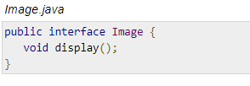
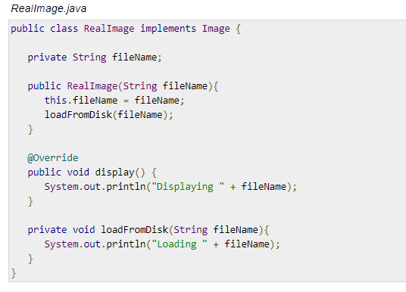
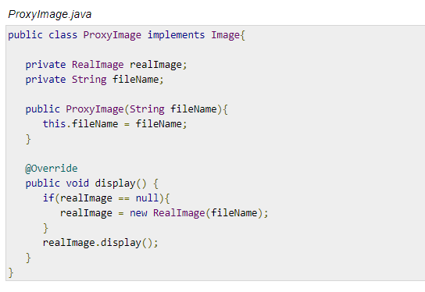
Proxy Pattern

Slide 4
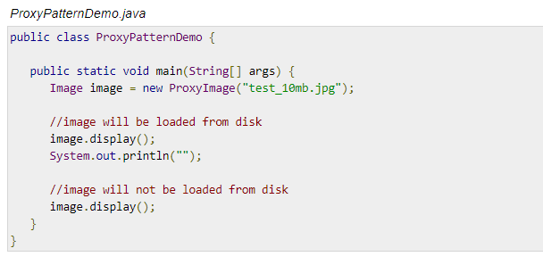
Proxy Pattern

Slide 5
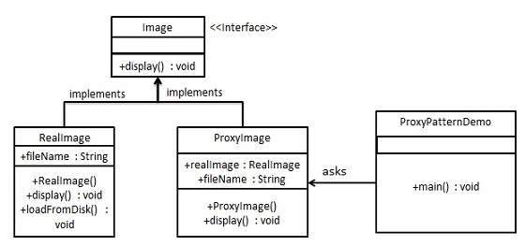
UML Diagram of Proxy Pattern

Slide 6
Memento Pattern
Memento pattern is used to restore state of an object to a previous state.
Memento pattern falls under behavioral pattern category.

Slide 7
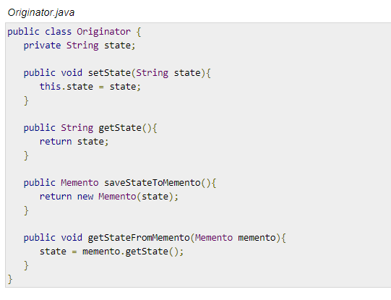
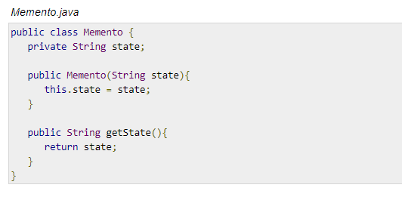
Memento Pattern

Slide 8
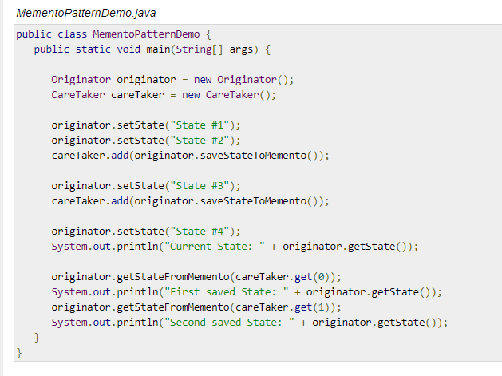
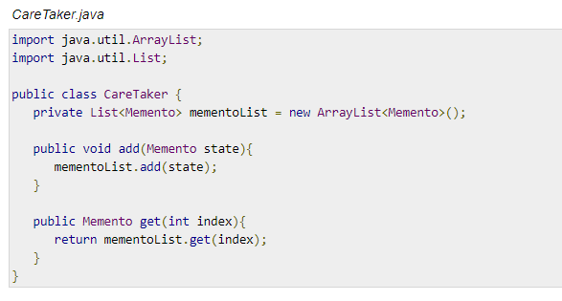
Memento Pattern

Slide 9
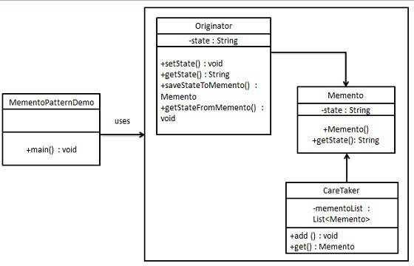
UML Diagram of Memento Pattern

